Slide 1
Workplace Ethics and Employee Lifecycle

Slide 2

Introduction
“In an ideal workplace, structures and relationships will work together around core values that transcend self‐interest.
Core values will inspire value‐creating efforts as employees feel inspired to do what is right, even when the right thing is hard to do”
SHRM Foundation – Shaping an Ethical Workplace Culture

Slide 3
Work Ethics
• The values and the culture in all interactions and relationships
• It is the moral compass
• Based upon a defined plan and strategy
• Continuously evaluated, monitored and communicated throughout the company
• Reflects honesty, integrity and transparency
According to the Ethics Resource Center’s 2013 National Business Ethics survey, 41 percent of US workers reported they had witnessed or observed unethical or illegal misconduct on the job.

Slide 4
Positive results of an ethical climate
Increased employee satisfaction
It results in trust between managers, employees and customers
Compliance with legal guidelines
Better organizational commitment
Reduction in turnover and retention of top performers
Effects of Unethical Climate
High turnover
Lower productivity
Increased costs
Poor morale

Slide 5
Scenario 1
George, a customer service representative, is working after normal business hours to finish an important project. He realizes that he is missing customer information that is in an email that was sent to his colleague, Sandra. George goes into Sandra’s office, only to realize that she is gone for the day. He sees her logon password taped to her computer on a sticky note. He decides to log into her computer and resend the email with the spreadsheet to himself. When scrolling through Sandra’s inbox, George sees a multitude of emails where Sandra is soliciting donations from vendors for her son’s baseball team.
If he reports what he has seen, he would have to admit to violating the company’s information technology regulations by logging into Sandra’s computer. If he confronts Sandra about her violation of the company’s solicitation policies, he would also have to reveal the source of his information.
What does George do in this situation?

Slide 6

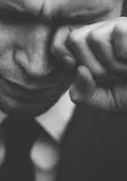

Ethics is NOT
Feelings
Religion
Compliance with the law
Following culturally accepted norms
Social and natural science

Slide 7

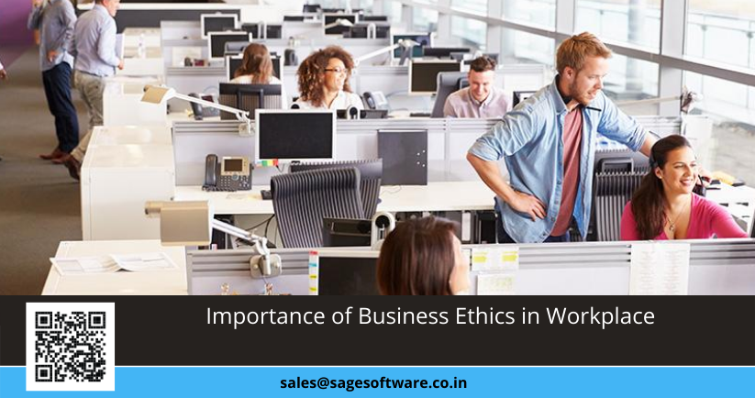


Top Work Ethics
Integrity
Respect
Productivity
Teamwork
Positive Attitude
Effective Communication
Good interpersonal skills
“Real integrity is doing the right thing, knowing that nobody's going to know whether you did it or not.” – ‐‐ Oprah Winfrey

Slide 8
Scenario 2
You and Funke are attending an Annual Conference in Victoria Island and decide to ride together. When you arrive at the hotel for check in and Funke presents her loyalty card, she is provided a N10,000.00 per night discount on her stay. The first evening of the conference, you and Funke are invited out to dinner by a consultant, who picks up the Bills. This also occurs on the second and third evening of the conference, so neither you nor Funke had any expenses for the dinner meals.
When you returned to the office after the conference, Funke advises you that she is claiming the maximum budget per day (which covers three meals), mileage, and the full hotel registration and expenses. She asks you to do the same so that your expense reports will match. She explains that she is having financial difficulties due to her son’s illness and the extra money would help pay some outstanding medical bills. She also reminds you how hard you both work and that the company did not provide a COLA this year, and that you both deserve to be compensated extra for the trip.

Slide 9

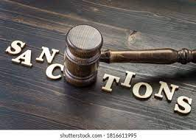
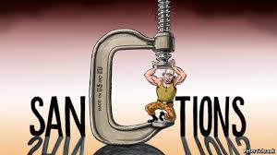
Offences/Sanctions
Management reserves the prerogative to discipline erring staff in accordance with FiberOne laid down rules and regulations.
Depending on the gravity of the offence, the case could be referred to HC disciplinary Committee session.
Counsel
Verbal Warning
Written Warning (first and final)
Separation
Termination
Summary Dismissal

Slide 10
Employee Life Cycle
The employee life cycle (ELC) is an HR model that identifies the different stages a worker advances through in an organization from application point to exit.
It is an organizational method used to visualize how an employee engages with the company they are a part of.
The employee life cycle covers the entire relationship between an employee and the organization they work for.
The employee life cycle model is geared to encompass every stage of an employee’s experience within a company, formatting that trajectory into a framework that provides a different engagement strategy for each stage the employee enters.

Slide 11
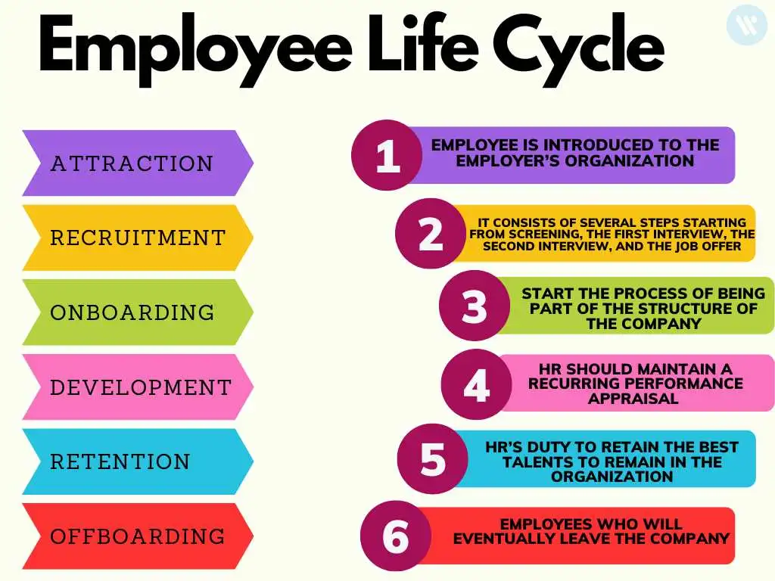
Stages of ELC

Slide 12

Class Exercise
What stage are you in the Employee Life Cycle?
Under what stage does Training and Development falls?

Slide 13


Slide 14
THANK YOU

